Slide 1
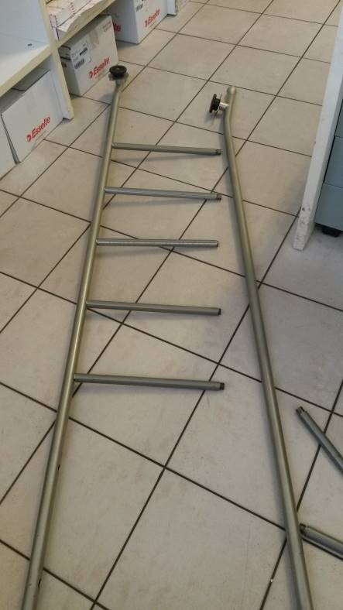
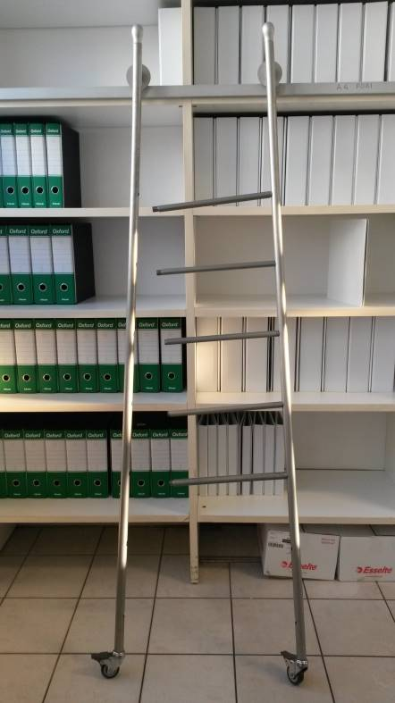
HS&E INCIDENT BULLETIN |  | 2nd half year 2017
Location Country: Italy | Type of incident : ladder breakage
Summary:
During the archiving of some documents, the ladder of the copies office has suddenly broken. The operator, who was climbing with a volume in his hand, jumped on the ground from the first rung (40 cm from the ground) as soon as the ladder broke.
Root Causes: | Actions Taken Thus Far: Next Steps
periodical check of offices ladders not expected | Verify also all the offices’ s ladders Include offices ladders in the periodical maintenance program

